Slide 1

LESSON 5 SPEAKING

Slide 2



PART 01
Quick Guide

Slide 3

Quick Guide : Describe a picture
- see and describe a photo (show a person or people involved in a common everyday activity in a familiar setting).
Duty:
+ 30 seconds to prepare
+ 45 seconds to give your response.
The photo will remain on the screen as you prepare and give your response.
Evaluation:
+ pronunciation, intonation, and stress.
+ use of appropriate vocabulary, correct sentence structure, the cohesion of response.
Photos will show common everyday situations.
» Dining out and shopping » Entertainment and leisure activities
» Health care settings » Outdoor and street scenes
» Household chores » Travel

Slide 4
PART 02
Walk through

Slide 5
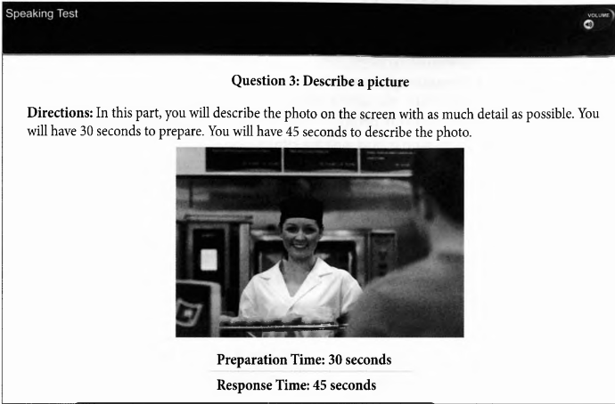
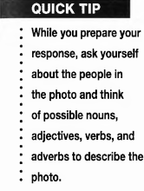
Describe a Picture
As soon as you see the photo, try to identify the main subject.
What are the important details in this photo?

Slide 6
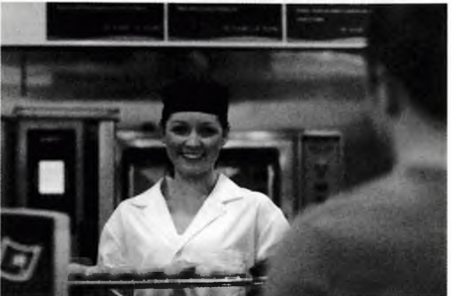

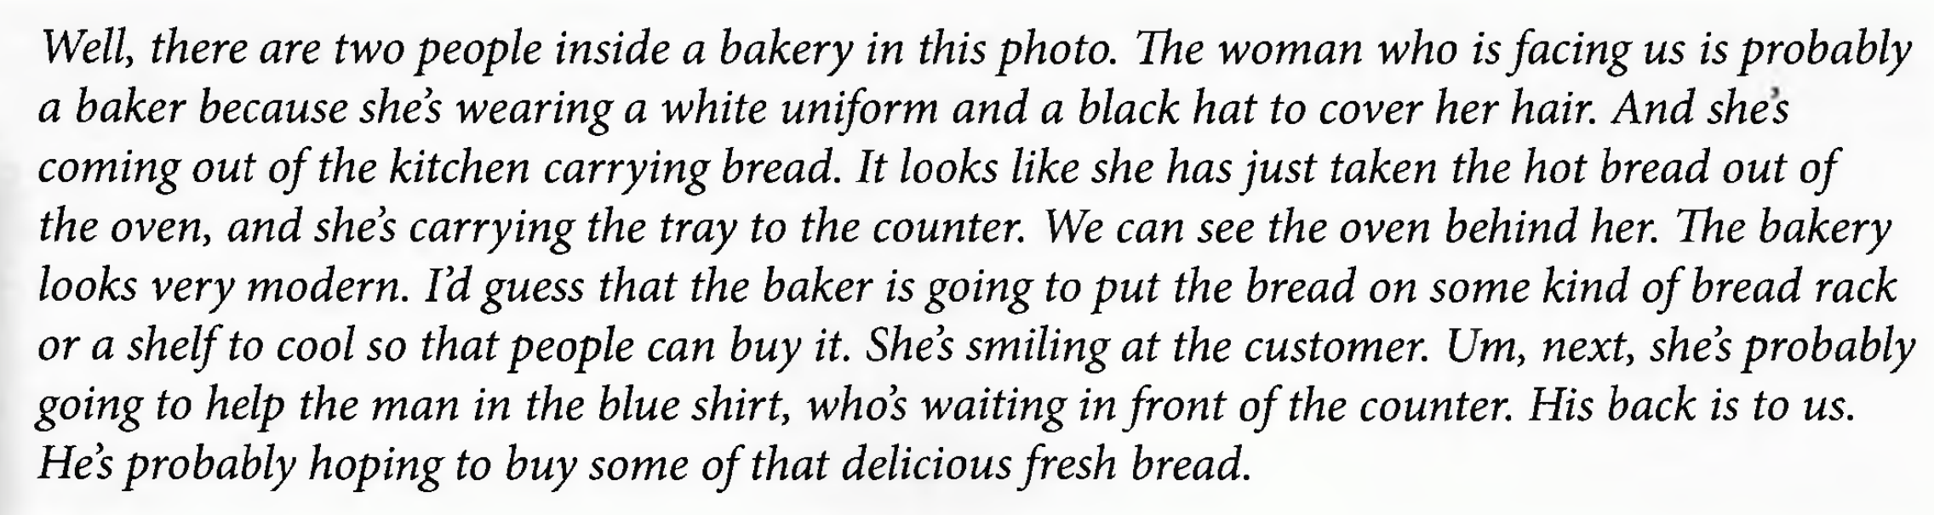
30 seconds to prepare your response.
time yourself while you brainstorm ideas.
look closely at the photo and identify the people.
think about what the people are doing.
listen carefully to the speaker’s pronunciation, intonation, and stress

Slide 7
PART 03
Get it right:
Grammar and Vocabulary

Slide 8
Tips and Tasks for Answering Correctly
Question 3 on the Speaking Test is scored on a scale from 0-3.
Vocabulary
+ the number of words
+ the kinds of words you use to describe the photo.
+ use a variety of vocabulary to accurately talk about what is in the photo.
Grammar
+ how well you use the correct forms of words
+ correct sentence structures
make a clear and accurate description of the photo.
+ try to use a variety of different grammatical structures.
Cohesion
+ how well the information in your description fits together in a clear and easy-to-understand manner.
+ a cohesive response uses conjunctions, references, and other language tools to make a well-organized description.

Slide 9
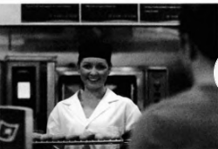
I see … people in the picture.
I think this must be …. (địa điểm).
There’s a …
Dự đoán: must be, seems to…, it looks like…, maybe, probably.
She/ He’s wearing… a
The oven, the bread

Slide 10
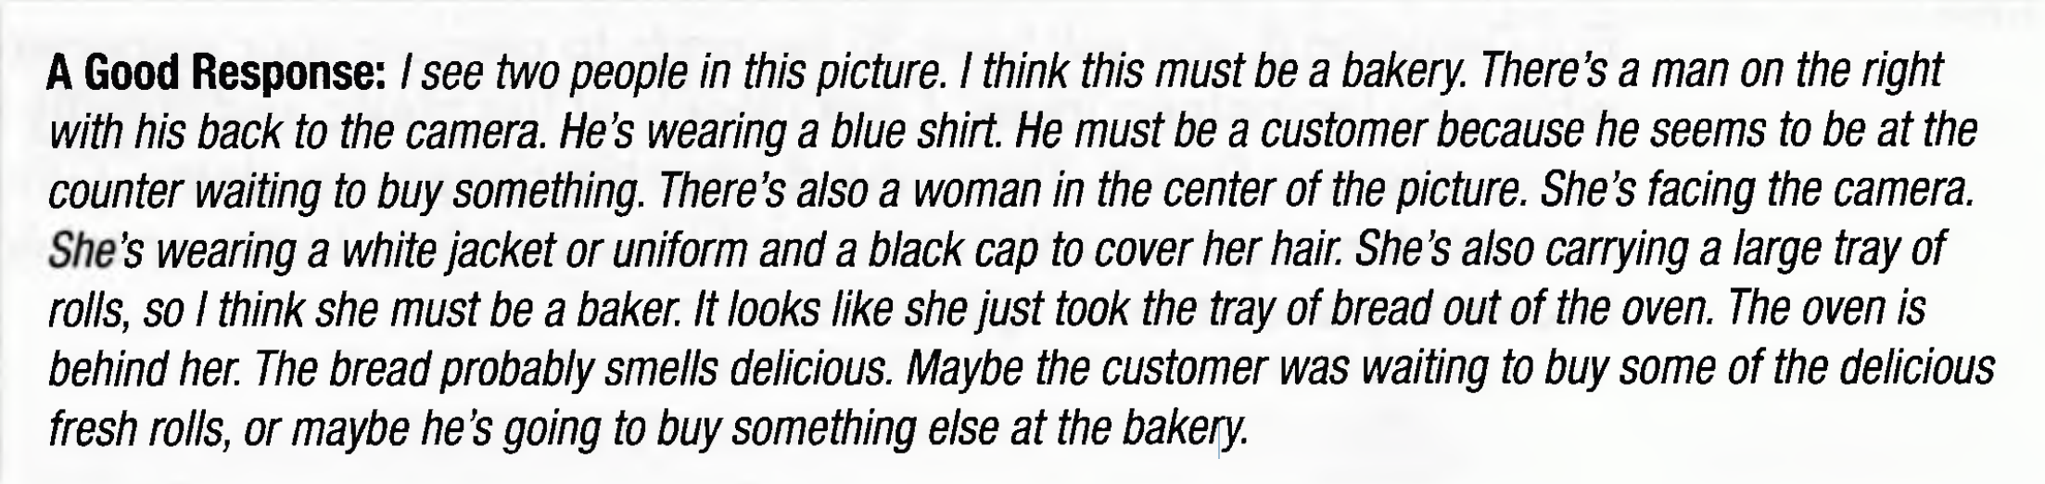
Look at the photo again as you listen to
another good response below. As you listen, circle the nouns and underline the verbs. How many different nouns for people or objects did around a main idea. you find?

Slide 11
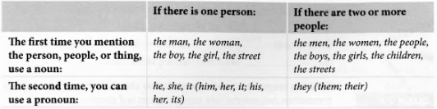
Grammar and Vocabulary
Quick tip:
Practice thinking of several different words to identify specific people and objects.
The woman in the sample photo can be referred to as woman, baker, she, or her, depending on context and grammar.
The man in the photo can be referred to as man, customer, he, or him.
You can practice describing magazine photos.
TIP1: Be sure to use the correct noun or pronoun and the correct verb form.
organize your response by asking yourself: who or what is the main subject in the photo?
- vary your response by using pronouns as well as different nouns to refer to the people and things in the photo

Slide 12
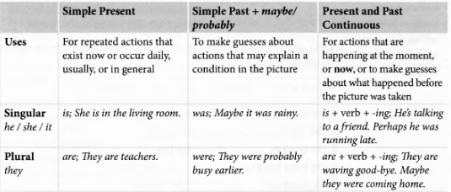
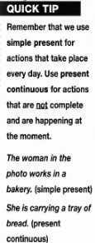
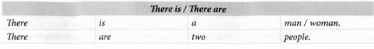
TIP 2 Use specific verb tenses and structures for basic descriptions.

Slide 13
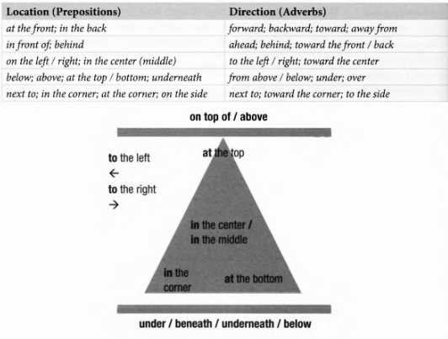
TIP 3 Use prepositions and adverbs to talk about location and how things move. Remember that prepositions and adverbs help specify location and direction.

Slide 14
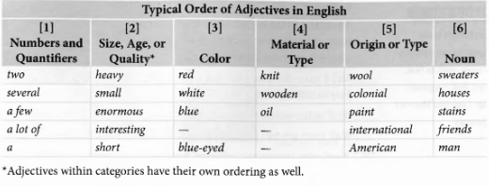
TIP 4 Use adjectives to give more information about people and objects.

Slide 15
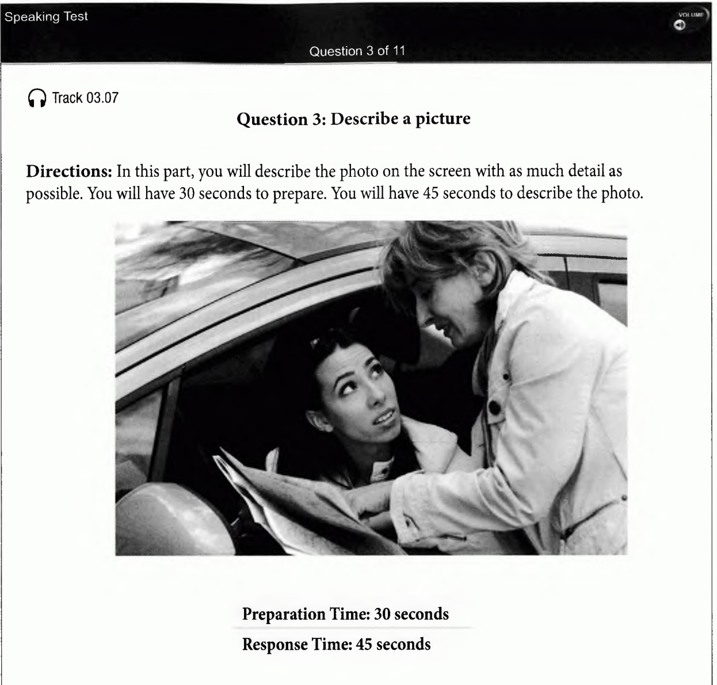
HOMEWORK

